Slide 1

Challenges to fulfill
UN Demographic Yearbook in Indonesia
Mariet Tetty Nuyetty
13-17 November 2017
Hanoi – Vietnam

Slide 2
Outline
UN Demographic yearbook?
Data source
Challenges
Recommendation

Slide 3
UN Demographic yearbook?
- The United Nations Demographic Yearbook is a UN statistics publication on population size, composition, births, deaths, marriage and divorce on an annual basis.
- It collects data from national statistical authorities through annual questionnaires, compiles and disseminates official statistics on a wide range of topics.

Slide 4
Questionnaires
  - Population estimates (11 tables)
  - Vital Statistics (43 tables)
  - International travel and Migration Statistics (9 tables)

Slide 5
Data sources
1. Census/surveys: Population census/survey
  - Mortality rates
  - Fertility rates
2. Civil registration: Population Administration Information System (SIAK)
  - Births
  - Deaths
  - Marriages

Slide 6
Population Administration Information System (SIAK)
Population Administration Information System (SIAK) is a national information system to facilitate the issuance of service or certificate of residence and the management of data and the results of the registration of civil registration with information and communication technology.
Managed by Directorate General of Population and Civil Registration, MOHA.
Standardize or establish mechanisms for administering the registration of the population and civil registration, especially birth, death, marriage and divorce.
Collect population data in a timely manner with a complete and thorough coverage and can be used for publishing documents and other public service population.

Slide 7
Implementation of SIAK
SIAK development is a mean to create a document recognition system in a single population
SIAK intends to provide demographic data and the results of the civil registration of civil registration in order to support the government, public services and development in autonomy;
Application of SIAK is to encourage each resident to report in an orderly manner and have the document on population and vital events that happened;
Implementation of SIAK can be pursued:
ownership of identity and residence documents population
support integration and data exchange between agencies serving residents population administration in an orderly and sustainable
ensure the security of individual data collected in a data bank and can be accessed in the national network system
realize the protection of civil and political rights of the population through the issuance of public records

Slide 8
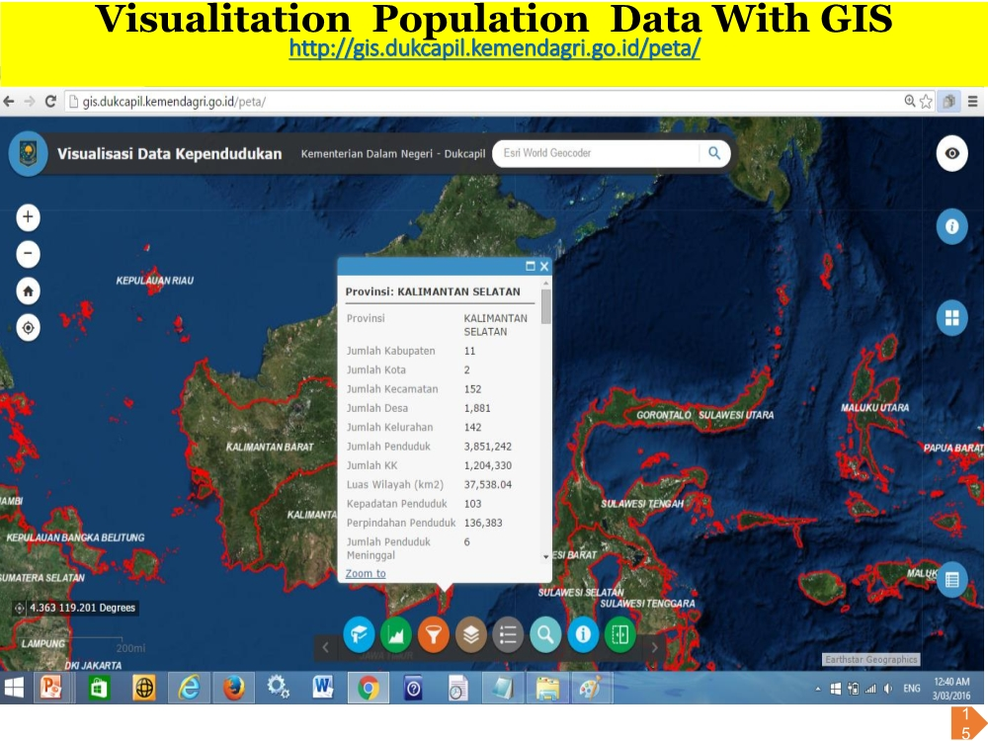

Slide 9
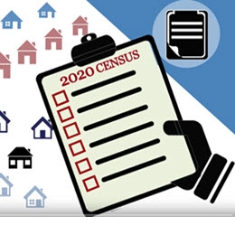
Population Census
The Population and Housing Censuses of Indonesia were conducted for the years 1961, 1971, 1980, 1990, 2000, and 2010. The 2020 Population and Housing Census was the seventh decennial census undertaken since the independence of Indonesia in 1945.
To be used as a complement and substitute of population registers
To count the de facto population of Indonesia:
  Calculate demographic parameters (Fertility, mortality and mobility)
  To be used as the basis of population projection
Plan 2020 Population Census, Using Register-based Census: Improvements in administrative data sources give rise to an opportunity to increase population coverage in census
Pre-printed list of families and individuals from population registry (SIAK)
Field verification (Short form) using CAPI in urban areas and paper-based in rural areas
Using Census Sample method (650 000 households)
Produce vital statistics based-on census/survey
Notes:
Preparation for Register Based Census
Menggunakan register dari MOHA untuk dasar pendataan
Membandingkan penduduk de jure dan de facto/usual residence
Dasar untuk pengembangan/perbaikan pengumpulan data statistik vital
2. Melihat cakupan pelaporan VS di setiap daerah
3. Menghasilkan indikator vital statistik sampai level kabupaten/kota (komplement/tidak dibandingkan dengan hasil pelaporan VS

Slide 10
Challenges
1. Rely on census and surveys for population, fertility, and mortality estimates
2. Lack of completeness and accuracy of civil registration data
3. Lack of awareness of civil registration
4. Lack of metadata
5. Registration system covers only certain vital events
6. Inadequate staff at provincial and district levels to manage the data
7. Limited coverage of the data, information not collected within the region
8. Coordination among agencies that provide vital statistics has not worked well
Limited data disaggregated
Notes:
Preparation for Register Based Census
Menggunakan register dari MOHA untuk dasar pendataan
Membandingkan penduduk de jure dan de facto/usual residence
Dasar untuk pengembangan/perbaikan pengumpulan data statistik vital
2. Melihat cakupan pelaporan VS di setiap daerah
3. Menghasilkan indikator vital statistik sampai level kabupaten/kota (komplement/tidak dibandingkan dengan hasil pelaporan VS

Slide 11
Recomendation
Socialization on the importance of vital event registration
Statistical capacity building for staffs in district or provincial Ministry of Home Affairs (MOHA)’s offices to capture the data
Training programmes on CRVS for district or provincial MOHA office staffs
Statistics office start to collect data from MOHA office
Other vital statistics should start being produced to meet users’ needs
Notes:
Preparation for Register Based Census
Menggunakan register dari MOHA untuk dasar pendataan
Membandingkan penduduk de jure dan de facto/usual residence
Dasar untuk pengembangan/perbaikan pengumpulan data statistik vital
2. Melihat cakupan pelaporan VS di setiap daerah
3. Menghasilkan indikator vital statistik sampai level kabupaten/kota (komplement/tidak dibandingkan dengan hasil pelaporan VS

Slide 12
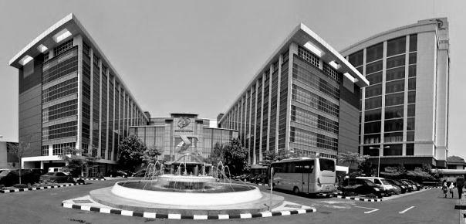






Terima Kasih
Thank You
www.bps.go.id
Jl. Dr. Sutomo 6-8 Jakarta 10710
bpshq@bps.go.id
(021) 3841195, 3842508, 3810291
Badan Pusat Statistik (Page)
(021) 3857046
@bps_statistics

